Slide 1


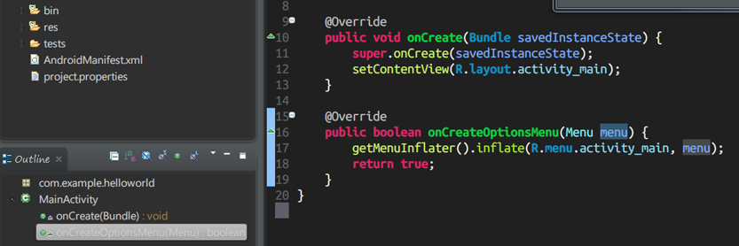
High-Quality Code: Course Introduction
Course Introduction
SoftUni Team
Technical Trainers
Software University
http://softuni.bg

Slide 2

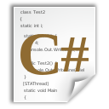


Table of Contents
Course Objectives
Course Program
Trainers Team
Examination
Learning Resources

Slide 3







SoftUni Diamond Partners

Slide 4

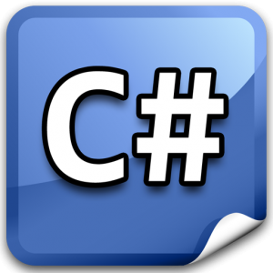



Level #2 at the Software University
OOP (C#, Java, PHP)
11 times + exam + TW
6 weeks * 2 times
JS OOP
5 times + exam + TW
3 weeks * 2 times
JS Apps
6 times + exam + TW
4 weeks * 2 times
Angular JS
4 times + project
3 weeks * 2 times
High-Quality Code
12 times + exam + TW
16 weeks * 1 time

Slide 5

High Quality Code
Course Objectives & Program

Slide 6



High-Quality Code Course Program
What Will Be Covered in the Course?

Slide 7
The Course Program
Course Overview. Introduction to High-Quality Programming Code.
Correctly Naming Identifiers in the Code (Classes, Properties, Methods, Parameters, Variables, etc.) Correctly Formatting the Code Code Documentation and Comments
Using Variables, Data, Expressions and Constants. Using Control Structures - Conditional Statements and Loops
High-Quality Methods, Cohesion and Coupling. High-Quality Classes and Class Hierarchies
Lab: Refactoring a Project

Slide 8
The Course Program (2)
Unit Testing
Mocking. Test-Driven Development
Lab: Unit Testing and Mocking
Defensive Programming and Exceptions. Code Refactoring. Refactoring Patterns
Effective Debugging: Tools and Techniques. Performance Tuning and Code Optimization
Development Tools. IDEs. Change Management Systems. Code Analysis Tools. Automated Testing Tools. Automated Build Tools

Slide 9
The Course Program (3)
SOLID Principles, DRY, YAGNI, KISS, DIP, …
Design Patterns – Creational, Structural and Behavioral Patterns
Fundamentals of Software Engineering (Requirements, Architecture, Design, Implementation, Testing, Deployment, Support). Development Methodologies. Project Management
Lab: Design Patterns and SOLID principles
Software Quality Assurance
Teamwork Projects Defense
Exam Preparation
Practical Exam

Slide 10

The Trainers Team

Slide 11
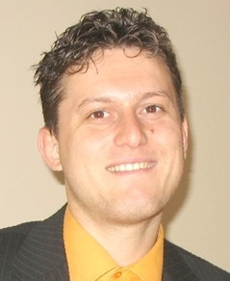
Trainers Team
Svetlin Nakov, PhD
Training & Inspiration Manager @ Software University
20+ years software development experience
10+ years experience as a trainer
Author of 7 programming books
Speaker at hundreds of events
Web site & blog: www.nakov.com

Slide 12
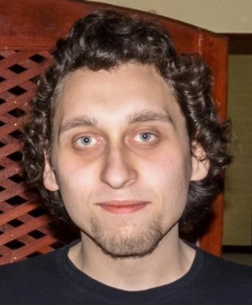
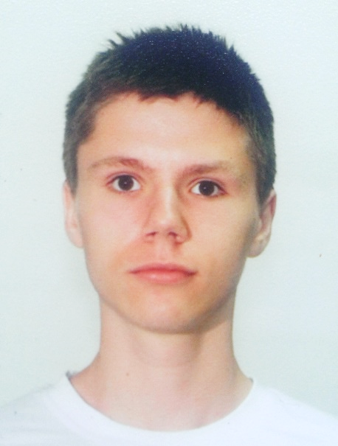
Trainers Team (2)
Yordan Darakchiev
Trainer @ Software University
Top performing graduate from the Software Academy (2013)
Top performing student at the Software University (2014)
Atanas Rusenov
Trainer @ Software University
Top performing student at the Software University (2014)

Slide 13


Trainers Team (2)
Vladimir Georgiev
Software engineer & Trainer @ Software University
Top performing graduate from the Software Academy (2013)

Slide 14

High-Quality Code Course: More Details
Duration, Languages, Technologies

Slide 15


Course Duration
Lectures: ~ 48 hours (onsite + YouTube videos)
Homework: ~ 30-50 hours
Teamwork: ~ 10-20 hours
Exam preparation: ~ 20 hours
Exam: 6 hours
Schedule: 21 Jan – 3 May
Exam dates: 3 May 2015

Slide 16



Why English?
Why the slides are in English?
English is the native language of software engineers
Specific terminology should be in English
Translations are inaccurate and funny
Just learn English!
No excuses

Slide 17
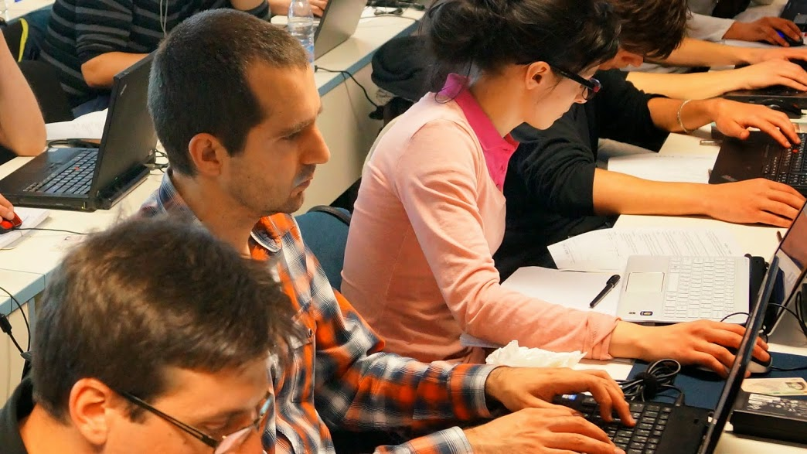


High-Quality Code Course
Evaluation Criteria

Slide 18


Scoring System for the Course
Exam: 75% (80% for online students)
Labs: 10% (onsite students)
Teamwork: 10%
Homework + evaluation: 5% + 5%
Presence in class: 5% (onsite students only)
Bonuses: up to 10%

Slide 19
The Exam
Practical refactoring and unit testing for 6 hours:
You are given an existing C# project – bad code
Find and fix the bugs
Refactor the code to improve its quality
Write unit tests
Find performance bottlenecks
Document the code

Slide 20

Homework Assignments
Doing your homework is very important!
Programming can only be learned through a lot of practice!
You should write code every day!
Each lecture is followed by a few exercises
Try to solve them in class
The rest are your homework
Homework assignments are due in 1 week after each lecture
Submission will be accepted through our web site: softuni.bg

Slide 21

Homework Peer Reviews
Give feedback to a few random homework submissions
Students submit homework anonymously
Please exclude your name from the submissions!
For each homework submitted
Students evaluate 3 random homeworks
From the same topic, after the deadline
Give written feedback, at least 200 characters
Low-quality feedback → report for punishment
Everyone will get feedback for their homework

Slide 22









Resources
What Do We Need Additionally?

Slide 23

Course Web Site & Forums
The course official website:
Register for the "Software University Forum":
Discuss the course exercises with your colleagues
Find solutions for all course exercises
Share source code / discuss ideas / help each other
https://softuni.bg/courses/high-quality-code/
https://softuni.bg/forum

Slide 24



Slides and Videos
All lecture slides, videos, homework assignments, projects and other resources are open content, available for free
Visit the course web site to access the course resources

Slide 25
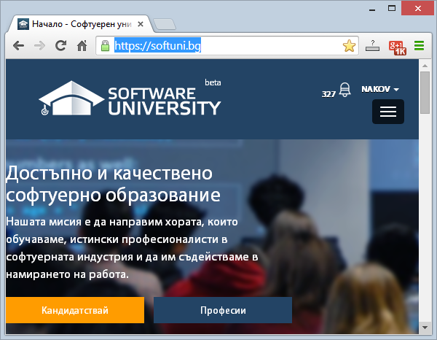
Software University Learning System (SULS)
Software University Learning System (SULS)
www.softuni.bg
Important resource for students
Homework submissions
Homework check-up
Exams and results
Reports about your progress
…

Slide 26
High-Quality Code – Course Introduction
https://softuni.bg/courses/high-quality-code/

Slide 27

License
This course (slides, examples, demos, videos, homework, etc.) is licensed under the "Creative Commons Attribution-NonCommercial-ShareAlike 4.0 International" license
Attribution: this work may contain portions from
"High Quality Code" course by Telerik Academy under CC-BY-NC-SA license

Slide 28





Free Trainings @ Software University
Software University Foundation – softuni.org
Software University – High-Quality Education, Profession and Job for Software Developers
softuni.bg
Software University @ Facebook
facebook.com/SoftwareUniversity
Software University @ YouTube
youtube.com/SoftwareUniversity
Software University Forums – forum.softuni.bg

